Slide 1

Socio-Economic Visualization with World Bank Indicators
IE 6600 - Group 1
Debanjan Saha
Zeyuan Liu
Guangyu Han

Slide 2

Why we chose this problem?
Poor Economic Conditions
World Economic Pattern during these time

Slide 3
User Stories:
For a specific indicator, what is its global and local trends within a period of time?
Within a given time, will the same indicator behave differently in different countries or regions?
Given a specific country and year, what are the correlations between different or similar indicators?
Use Time Series Analysis to cluster the countries with similar pattern.

Slide 4
Design
We choose the top 100 indicators that play a crucial part in defining the movement of the global economy
Visualize the impact of the indicators on world map using Plotly-Dash
Apply Time Series analysis and clustering to segregate the data into different economic groups with similar time trends.

Slide 5
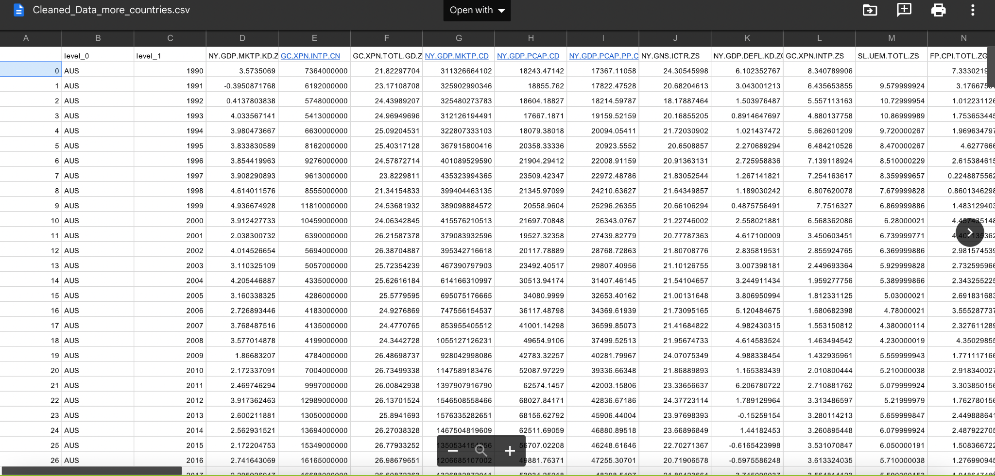
Dataset

Slide 6
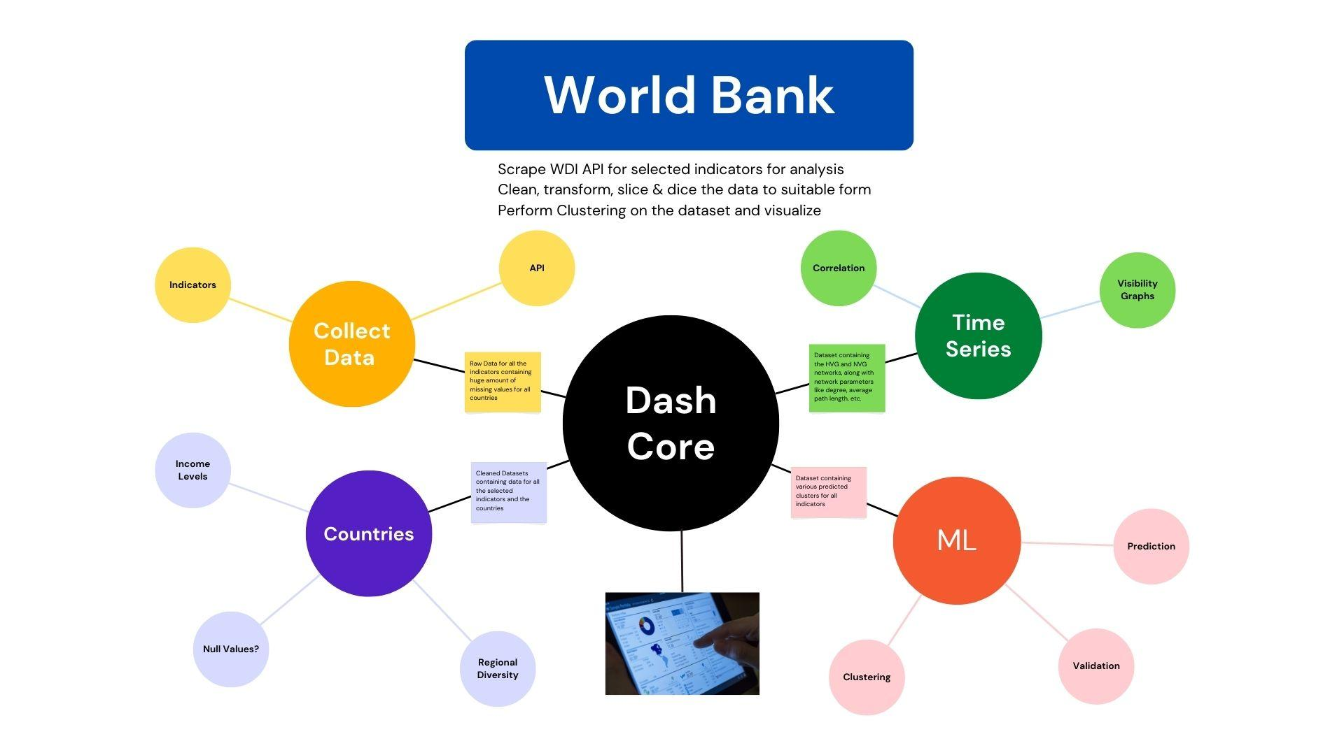
Our project has several colab notebooks and csv files. Our project structure is below.

Slide 7
Web App Demo
UI (User Interface) Front End
Indicators Selector Dropdown
For each selected indicator, utilize a Choropleth map with a slide bar on years, a scatter plot on Visibility Graphs, and lastly cluster the data on all indicators using KMeans clustering methods.
Data Visualization with Interactivity
Any indicators could be shown in three graphs to the users if the users use the indicator selector
Any years’ data could be shown in the first map if the users use the slide bar.
Zoom in, zoom out, select and other plotly operations.
Want to see it? Let’s gooooo!

Slide 8
Basic Analytics and Conclusion
From 1990 to 2020, the overall trend of most measures connected to GDP is quite unstable. The plausible explanation is that the global economic situation changes often. However, if people focus only on a short time period, they will see a definite trend.
For example, Global GDP growth (code: NY.GDP.MKTP.KD.ZG) has clearly decreased from 2014 and 2015. During 1995-1997, the same indices showed a consistent upward tendency. As a user curious in historical economic growth rates, this web application is ideal for analysis.
User story page

Slide 9
Basic Analytics and Conclusion
Almost every indicator behaves differently in different nations and locations throughout time.
As a user who is interested in regional socioeconomic data discrepancies, like an UN offcial. It is an excellent research tool.
Using gross savings as an example (code: AG.PRD.FOOD.XD), China has the highest value from 2000 to 2020, whereas Canada has a lesser value than China. It will be really beneficial to any people who are interested in this subject.
User story page

Slide 10
Basic Analytics and Conclusion
Correlations between distinct or comparable indicators may be readily determined in this online tool given a certain nation and year.
As a user who is interested in the linkages between socioeconomic data,like a data scientist. This web application can meet their needs.
For example, the United States saw a period of rapid GDP growth (code:NY.GDP.MKTP.KD.ZG) in 2000. If we continue to adjust the value in the indication selector. We shall discover that the United States had a lower unemployment rate in 2000 too, indicating a negative link between GDP growth and unemployment.
User story page

Slide 11
Time Series Analytics - Features Engineering
The Natural Visibility Graph (NVG) and Horizontal Visibility Graph (HVG) are recent feature engineering methods. It will extract characteristics from time series data and turn them into complex graph networks, making it ideal for high-dimension time series data analytics.
To determine the similarity of the time series, many network characteristics like degree, diameter, average path length may be collected.
Furthermore, the retrieved features from the complex networks may be employed as additional features in a variety of machine learning applications.

Slide 12
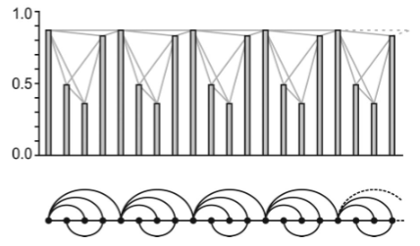
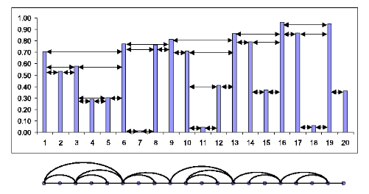
NVG & HVG
Reference:
1.Luque, Bartolo, et al. "Horizontal visibility graphs: Exact results for random time series." Physical Review E 80.4 (2009): 046103.
2.Lacasa, Lucas, et al. "From time series to complex networks: The visibility graph." Proceedings of the National Academy of Sciences 105.13 (2008): 4972-4975.

Slide 13
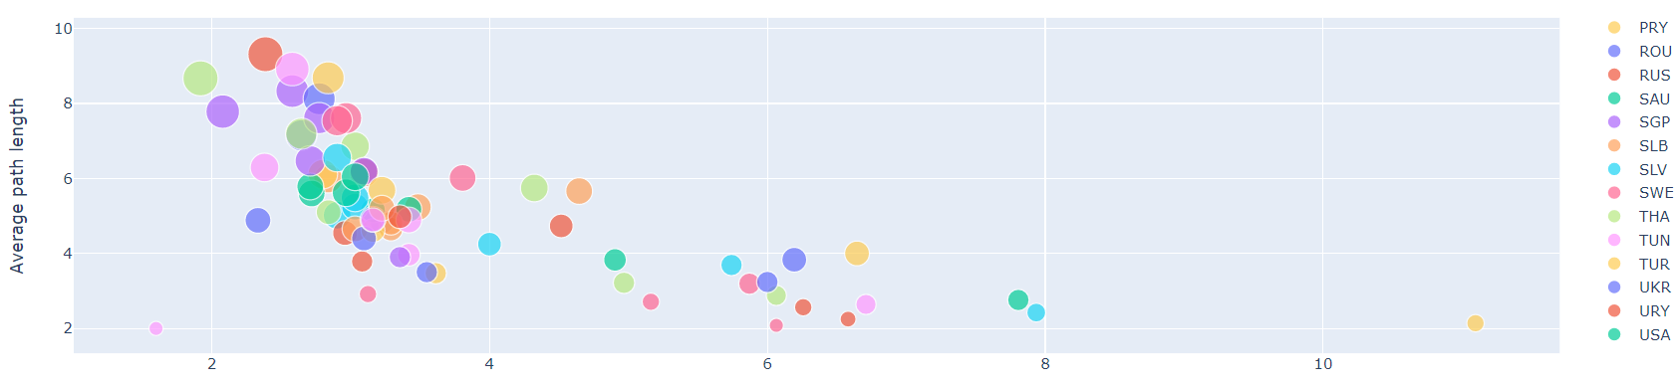
Countries Clustering using Time Series Features
According to the time series techniques, we find that some indicators cannot draw rational conclusion because the difference between clusters are not clear. But some indicators will provide us with useful conclusion.
Take Domestic credit to private sector (% of GDP)(code:FS.AST.PRVT.GD.ZS) as an example. All the countries are separate into 2 clusters.

Slide 14
Countries Clustering using Time Series Features
As an user who cares about countries’ pattern. This web app provides hints for studying the pattern of the Domestic credit to private sector (% of GDP).

Slide 15
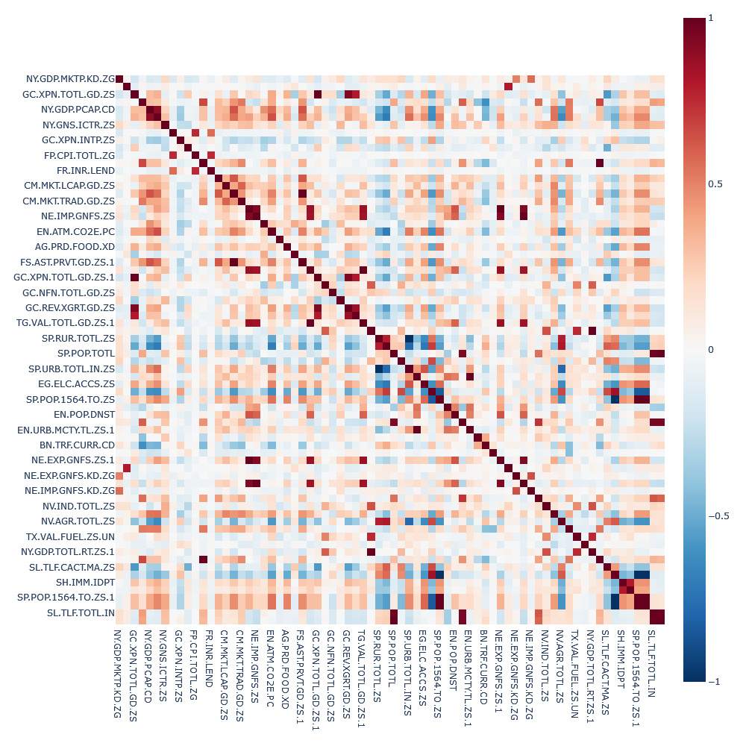
Correlation amongst Indicators
On our analysis we find there is some correlation among the indicators.

Slide 16
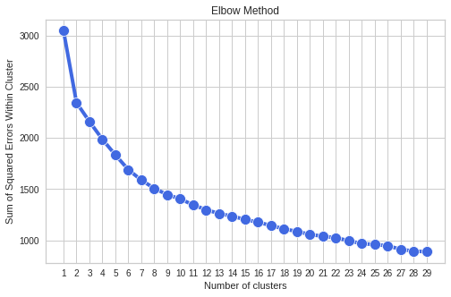
Clustering using Unsupervised Machine Learning
We also use unsupervised KMeans clustering techniques to implement clustering.
To determine the optimal number of clusters, we employ traditional methods (elbow method) as well as a variety of internal validation measures. Internal validation procedures employ distance-based (euclidean) metrics to determine the cluster's cohesion and adhesion attributes.

Slide 17
Internal Validation Metrics
We choose four internal validation metrics namely:
Calinski-Harabasz Index
Dunn Index
Silhouette Score
Davies-Bouldin Index
Finally, we use Silhouette Score Average and Davies-Bouldin Index to select the optimum number of clusters, which is three.

Slide 18
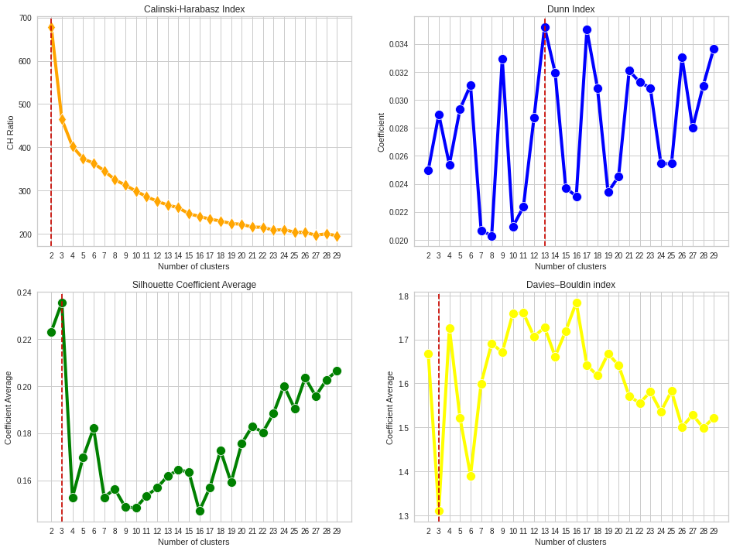
Optimal Clusters

Slide 19
Project Complexity
We implemented an end-to-end data science solution in this project, starting with framing the problem statement, collecting data from web APIs, cleaning the data, imputing missing values, transforming the data, performing time series analysis, feature engineering using complex networks, and finally clustering with unsupervised machine learning. Furthermore, the findings from the research was served via ngrok tunneling on a Plotly-Dash web app. Overall, the complexity is fairly difficult and fits the requirements for a 6000 series course.

Slide 20
Member Contributions*
Debanjan Saha (33%): primary contributions include problem framing, data visualization, dash core, machine learning
Zeyuan Liu (33%): primary contributions include data visualization, time series analysis, feature engineering
Guangyu Han (33%): primary contributions include data scraping, data preprocessing such as cleaning, wrangling, transformation
*equal contribution, ordered by descending surname

Slide 21

Questions?

Slide 22
THANK YOU!

